Slide 1

APEX INSTITUTE OF TECHNOLOGY
DEPARTMENT OF COMPUTER SCIENCE & ENGINEERING
Agile Practices (22CSH-292)
Faculty: Mamta Sharma(E15565)
Lecture 1.4: product design challeneges
DISCOVER . LEARN . EMPOWER

Slide 2
Learning Outcome of this lecture
CO1 | Understand the Agile Methodology and comparing various other software development models with agile.
CO2 | Examine Scrum and test driven development
CO3 | Apply the various tools available to agile teams to facilitate the project
CO4 | Analyze the method to improve results for a specific circumstance
CO5 | Evaluate likely successes and formulate plans to manage likely risks or problems

Slide 3
Learning Outcome of this lecture
Unit | Name | Outcome
I | Understanding common Agile Practices in DevOps | Introduction to Product Management, Product Design and Requirement gathering, Product Design Challenges, UX Design, Product Development Methodologies, Product Marketing and Presentation, Traditional Software Development Methodologies, Problem/issues with traditional approach, Agile Development, Agile Manifesto, Scrum Model, Agile Estimations and Planning, Soft skills in agile
CO 1 Apply the Agile Methodology and comparing various other software development models with agile
T

Slide 4
Outline
History of Design Thinking
IBM Design Thinking Framework
References

Slide 5
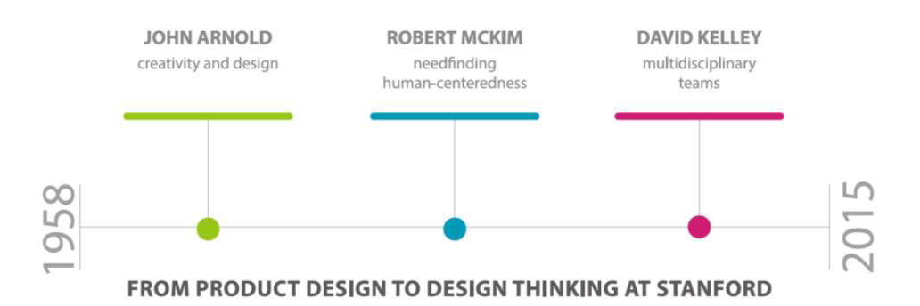
History of Design Thinking

Slide 6
History of Design Thinking
The 1960s: The term “Wicked Problems” is Coined
In the mid-1960s, Horst Rittel wrote and spoke extensively on the subject of problem-solving in design… so much so that he’s known as the design theorist who coined the term “wicked problem” to describe problems which are multidimensional and extremely complex. Rittel specifically focused on how design methodologies could be used to tackle wicked problems and how these methodologies were influential to the work of many design practitioners and academics of the time.
The 1970s: The Principles of Design Thinking Started to Emerge
Cognitive scientist and Nobel Prize laureate Herbert A. Simon was the first to mention design as a way of thinking in his 1969 book, The Sciences of the Artificial. He then went on to contribute many ideas throughout the 1970s which are now regarded as principles of design thinking.
The 1980s: Solution-Focused Problem-Solving was Observed
In 1982, Nigel Cross continued to make history in the design thinking world when he discussed the nature of how designers solve problems in his seminal paper “Designerly Ways of Knowing”. (Please note, this is not to be confused with his series of articles and papers similarly titled “Designerly Ways of Knowing”, published much later in the 2000s).

Slide 7
History of Design Thinking
1992
Richard Buchanan, then Head of Design at Carnegie Mellon University, published his article “Wicked Problems in Design Thinking”, which discussed the origins of design thinking. In the article, he discusses how the sciences developed over time to become more and more cut off from each other until they finally became specializations in their own right. He clarifies that design thinking is a means to integrate these highly specialized fields of knowledge so they can be jointly applied to the new problems we face in the world today—and from a holistic perspective.
2004
David Kelley founded the Hasso Plattner Institute of Design at Stanford—commonly known as the d.school. The d.school has made the development, teaching and implementation of design thinking one of its central goals since inception, and it serves as a source of huge inspiration to design thinkers across the world, including us here at the Interaction Design Foundation.
Present Day
At present, the design thinking movement is rapidly gaining ground—with pioneers like IDEO and the d.school paving out a path for others to follow. Other prestigious universities, business schools and forward-thinking companies have adopted the design thinking methodology to varying degrees, and have sometimes even re-interpreted it to suit their specific context or brand values.

Slide 8
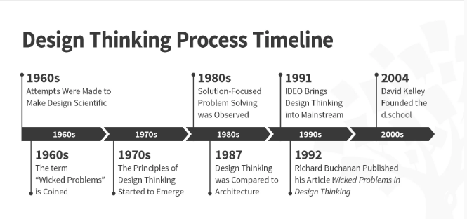
History of Design Thinking

Slide 9
IBM Design thinking framework
IBM is changing how it works and how it thinks about problem solving. IBM Design Thinking is our evolving methodology that we are using across key business units to drive more delightful outcomes to our users.
IBM developed Enterprise Design Thinking, a framework that aligns multi-disciplinary teams around the real needs of their users. When teams apply these scalable methods, they’re able to move faster and deliver differentiated outcomes repeatedly.

Slide 10
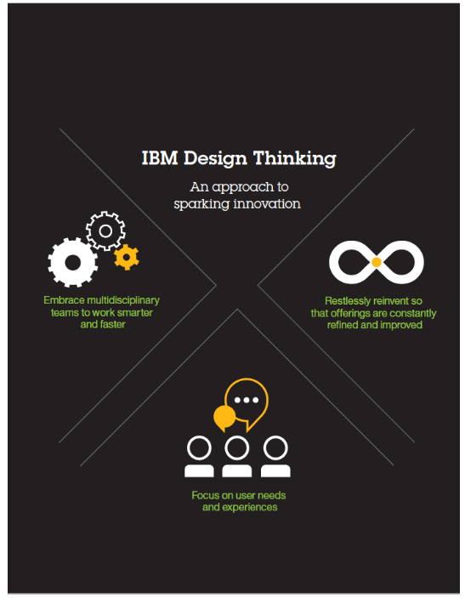

Slide 11
IBM Design thinking framework
IBM Design Thinking framework is placing end users at the center of innovation when tackling problems and developing solutions.
Bringing technologists together with executives, analysts and customer-facing financial advisors ingrains customer centricity in the innovation process, helping companies pivot quickly when market conditions change.

Slide 12
Text Books and Reference Books
T1 Agile Project Management with Kanban - Book by Eric Brechner
T2 Agile Foundations: Principles, Practices and Frameworks – Peter Measey
Reference Books:
1 Agile Project Management with Kanban Eric Brechner 2nd Microsoft Press 2021
2 Agile Foundations Peter Measey(4th BCS,) The Chartered Institute for IT 2015

Slide 13
References
https://www.mygreatlearning.com/blog/importance-of-design-thinking/
https://www.interaction-design.org/literature/article/5-stages-in-the-design-thinking-process
https://en.wikipedia.org/wiki/Design_thinking

Slide 14
THANK YOU
For queries
Email: mamta .e15565@cumail.in

